Slide 1

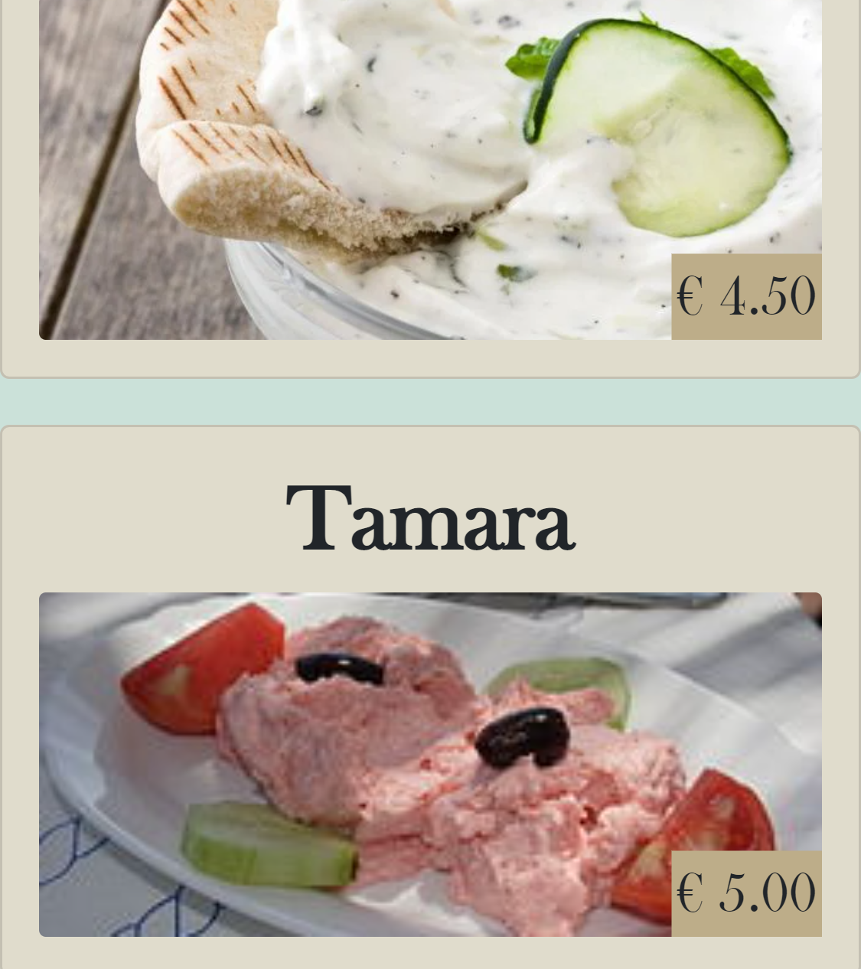

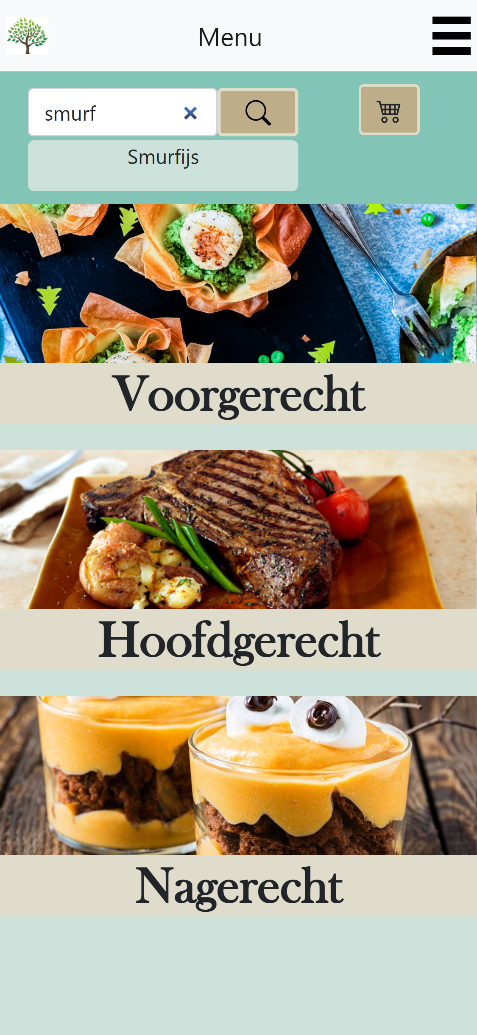
Customer App Sprint 4
Onderdeel van RigS

Slide 2

Inhoud
Sprint planning
Demo
Planning sprint 5

Slide 3

Sprint planning
4 Guest can select by the category of food they need.
6 Guest can filter tags.
10 Guest can add a note to a product, before going to order.
15 Guest can call an employee when he has a problem
18 Guest can view their order status.
19 Guest can download their bill.
Application has color implementation.
Guest can change Table.
Orders are merged with counter.

Slide 4
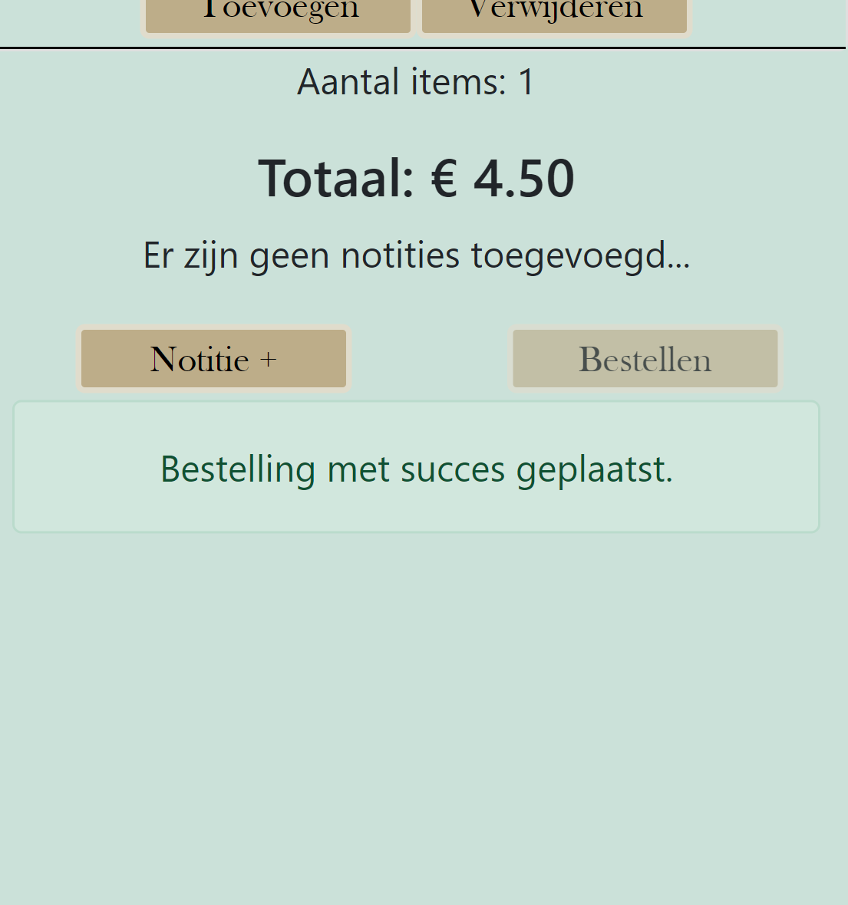
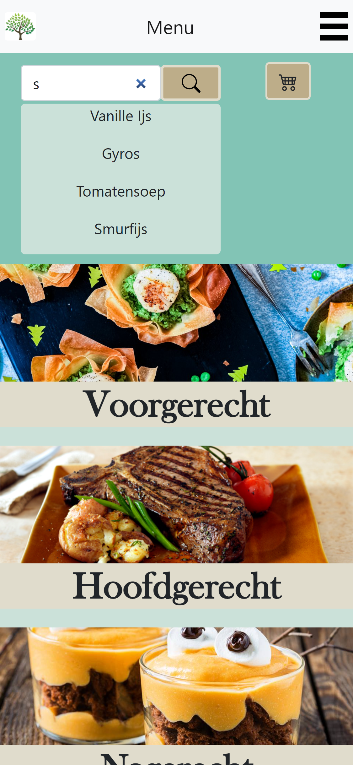
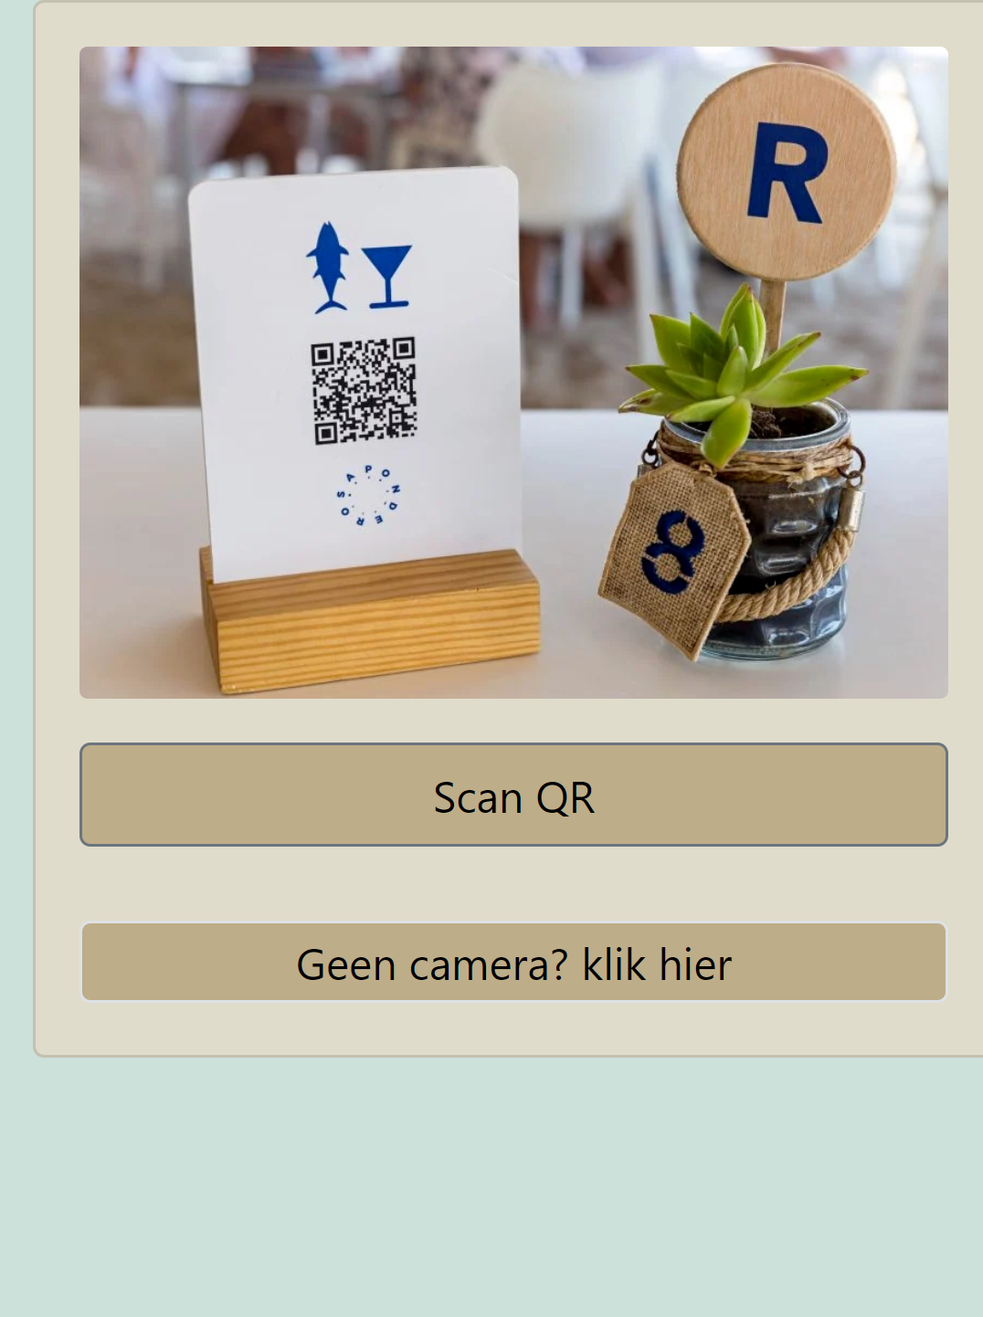

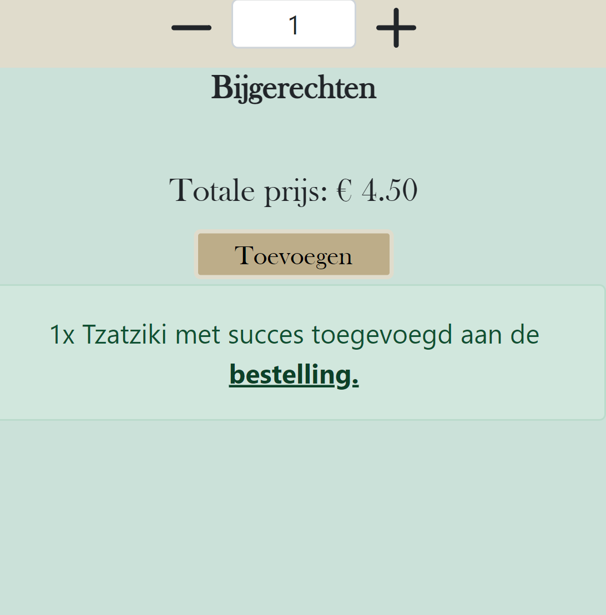
DEMO

Slide 5

Planning sprint 5
Combine group project to azure web services.
Bug fixing.
Finish documentation.
CI/CD optimalization.

